Slide 1

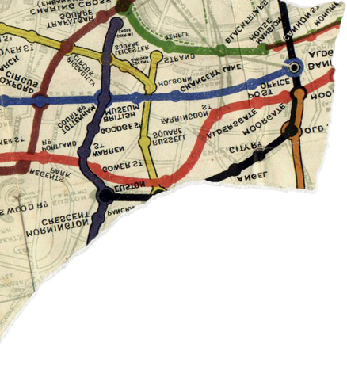
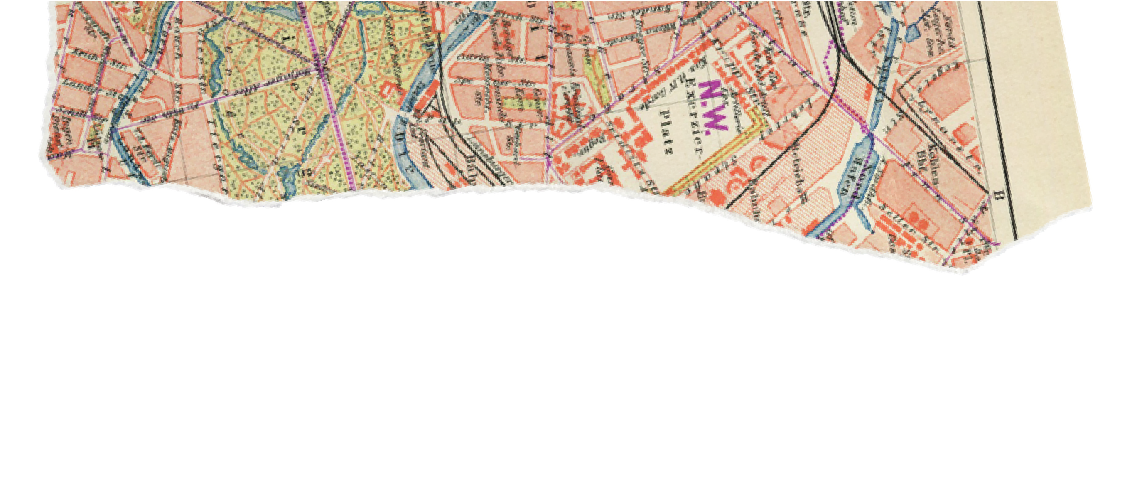
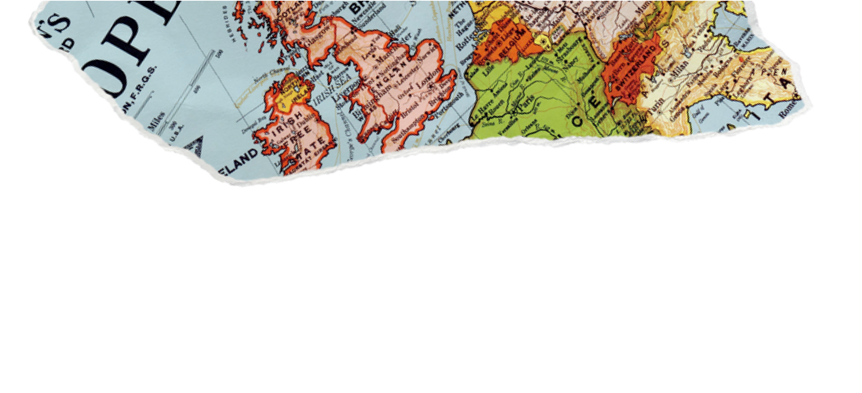
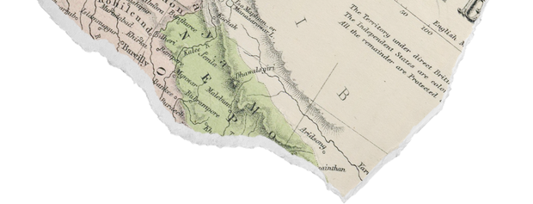
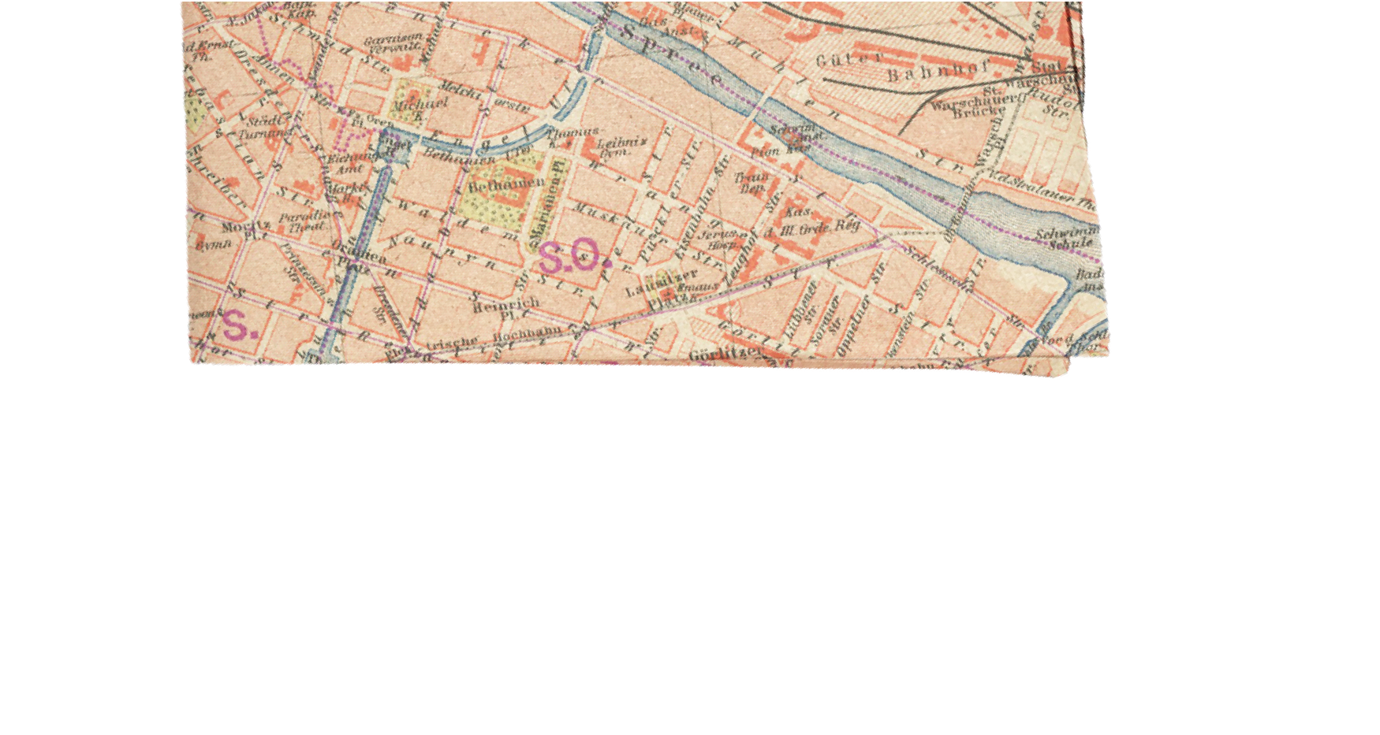
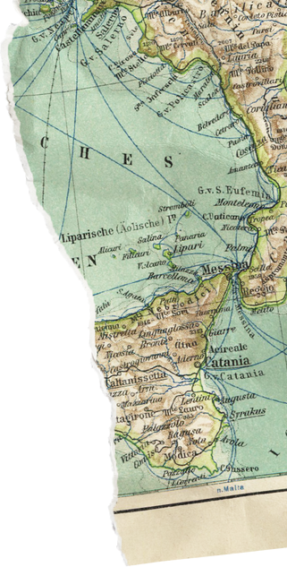


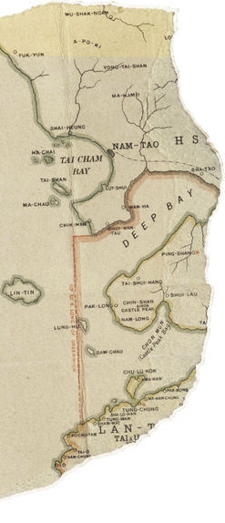
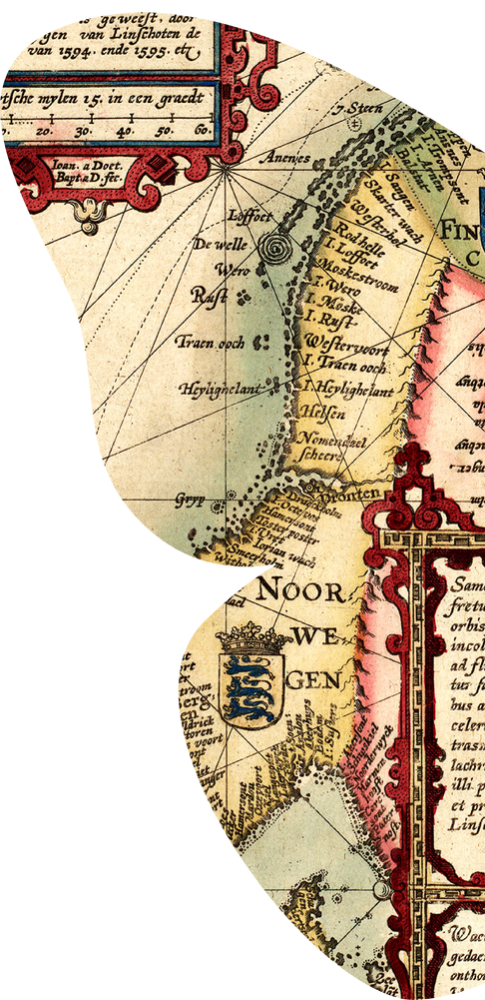

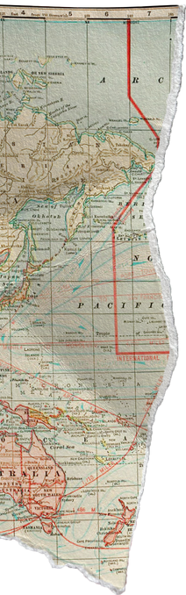
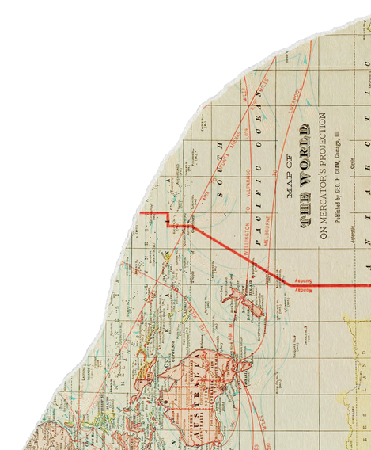
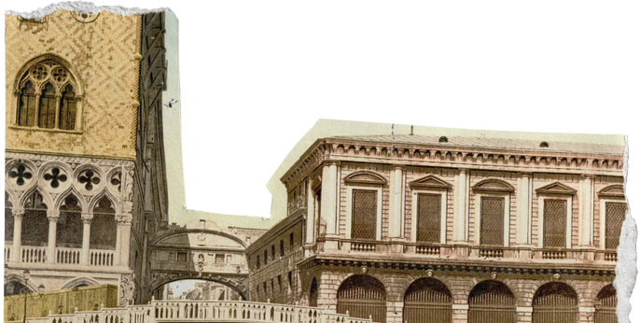

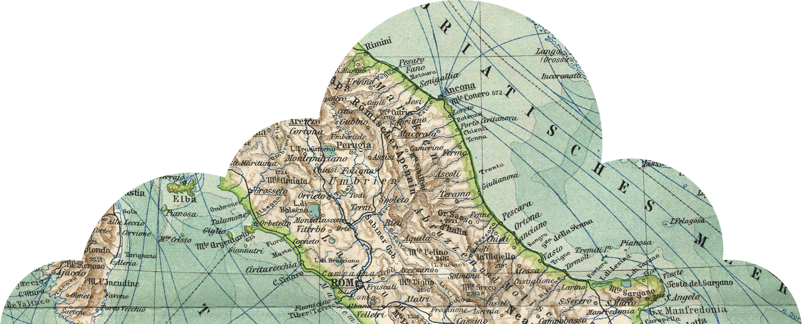
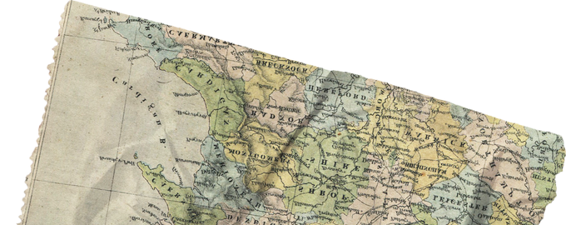
TRAVEL PLANNER
BY:
NAVEEN U (RA2211003010203)
GAYATHRI H V (RA2211003010200)
JAYANI E (RA2211003010206)

Slide 2
OVERVIEW:
Target Audience: The Travel Planner is designed for travelers, tourists, and trip organizers. It caters to individuals and groups planning trips or vacations.
Motivation: The motivation behind developing the Travel Planner was to address the need for an easy-to-use and efficient tool for trip planning. We recognized the challenges that travelers often face when organizing their trips and aimed to provide a user-friendly solution.
User-Centric Approach: The Travel Planner has been designed with a user- centric approach. We focused on creating a seamless travel planning experience, ensuring that users can effortlessly plan their trips, add destinations, create itineraries, and sort their travel information.

Slide 3
ABSTRACT:
The "Travel Planner" is a user-centric, text-based application designed to simplify and enhance the process of trip planning for travelers, tourists, and trip organizers. With a focus on ease of use, efficiency, and flexibility, this application offers a range of features that cater to the diverse needs of travelers.
Motivated by the recognition of the challenges that travelers often face when organizing their trips, the "Travel Planner" was developed as a comprehensive solution. The application empowers users to create and manage their travel itineraries, add destinations to visit, and sort them for quick reference.

Slide 4
FEATURES:
Adding Destinations: Users can input destination names and descriptions to build their list of places to visit. This feature allows for easy organization and reference.
Creating Itineraries: The Travel Planner allows users to set specific dates for their trips and manage multiple itineraries for different journeys. Itineraries are a core component for planning and scheduling travel.
Sorting Destinations: Users benefit from the ability to organize their destinations. Destinations can be sorted alphabetically, making it easier to find and choose the next place to visit.
Viewing Itineraries: Travelers can review their itineraries to get a comprehensive overview of their travel plans. This feature provides a quick reference to what's planned for their trips.

Slide 5

DATA STRUCTURES:
Array and Linked List: The Travel Planner utilizes an array for managing destinations, allowing users to add and sort their desired locations. For itineraries, a linked list structure is employed, enabling the management of trip plans.
Purpose-Driven Data Structures: Different data structures serve different purposes. Arrays are efficient for static lists like destinations, while linked lists provide flexibility for dynamic itineraries.

Slide 6

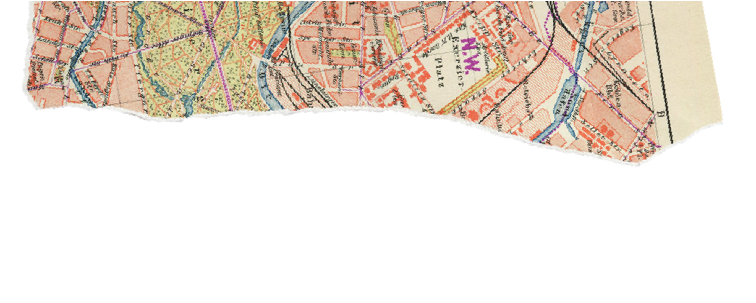
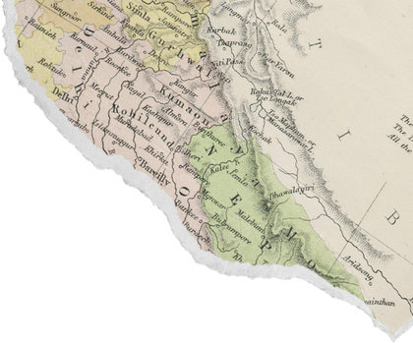
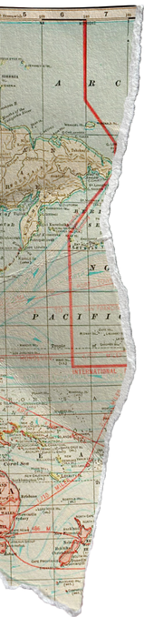
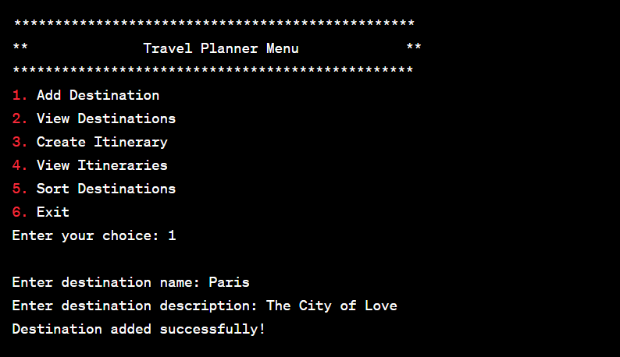
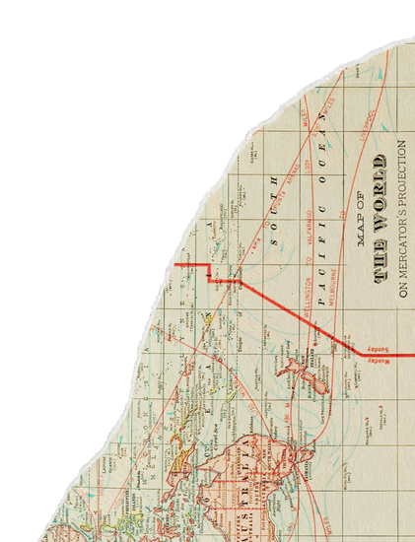


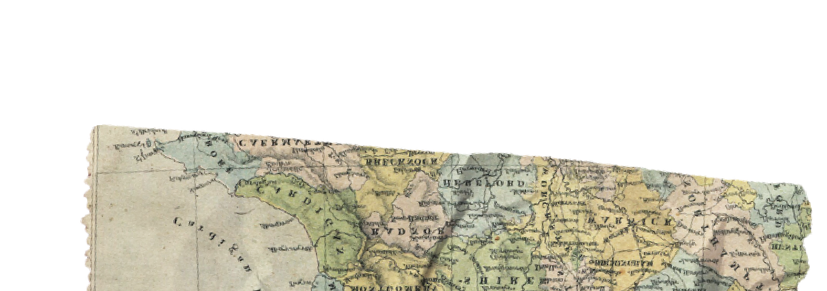
CODE SOURCE:
https://github.com/naveen2624/Travelplanner
OUTPUT SCREENSHOT:

Slide 7
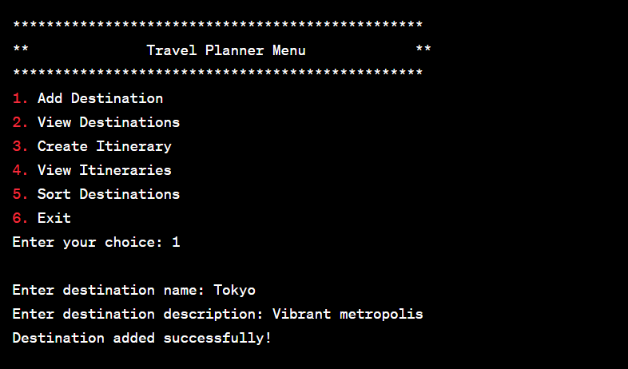
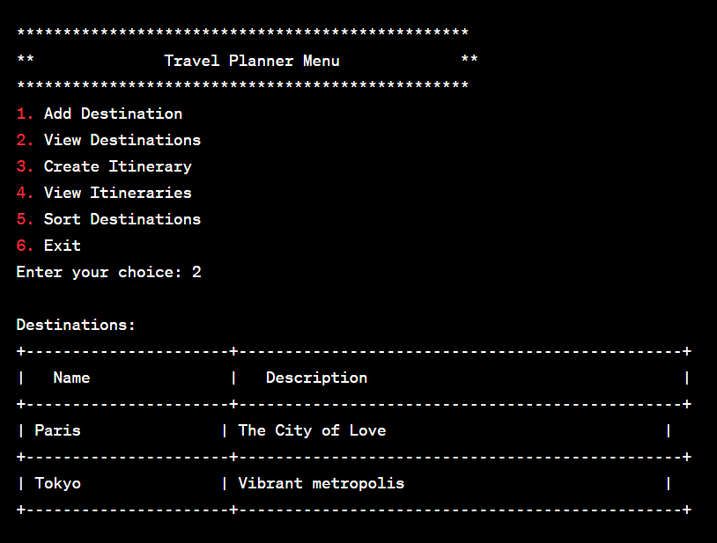

Slide 8
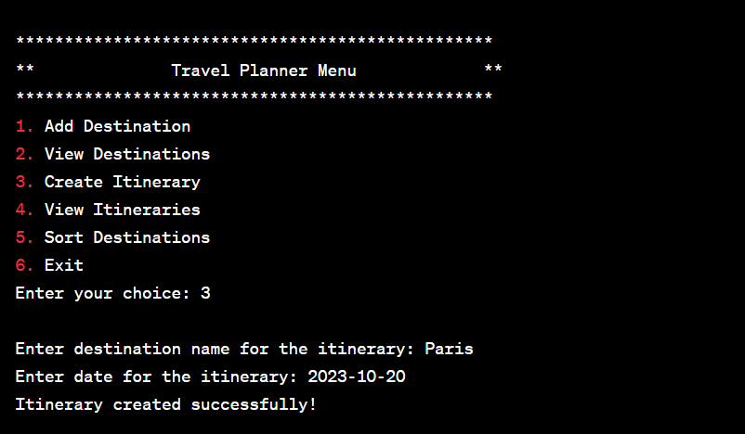
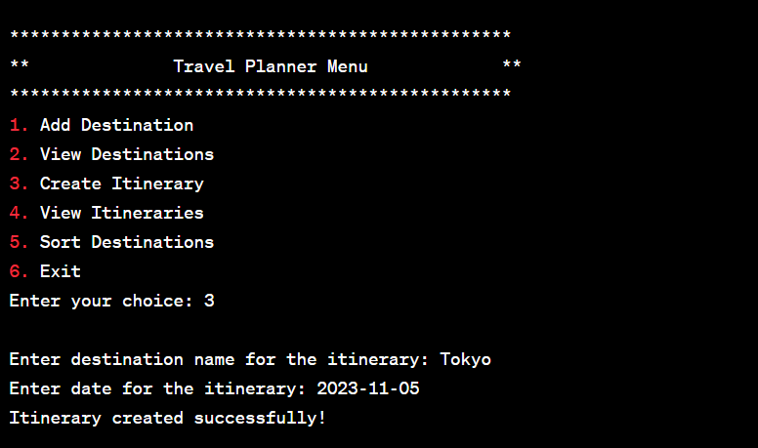

Slide 9
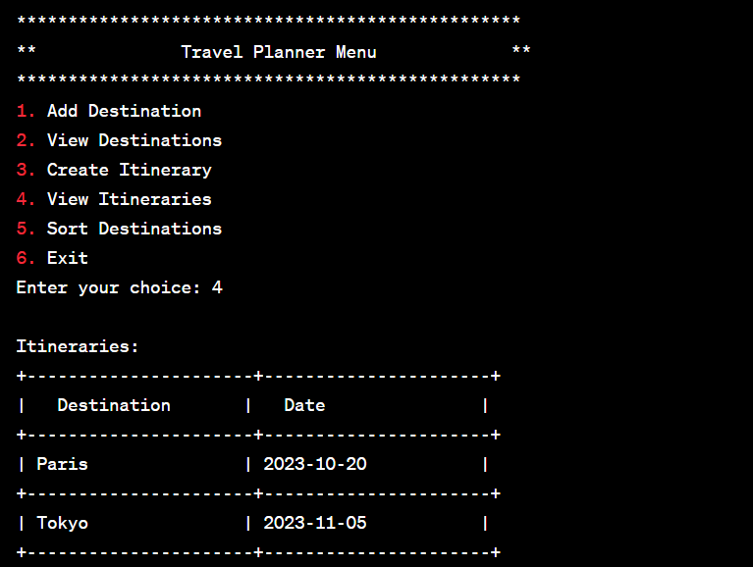
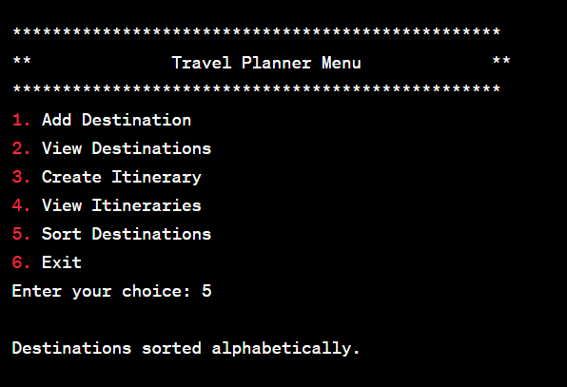

Slide 10
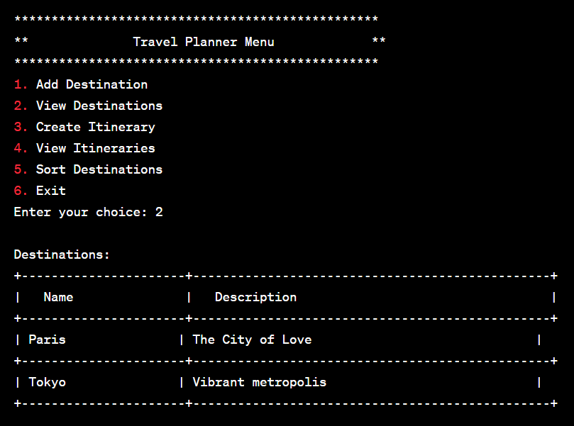
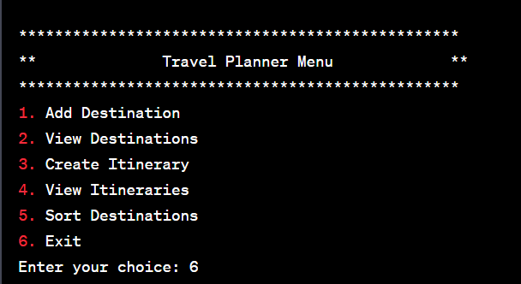

Slide 11



GITHUB LINK:
https://github.com/naveen2624/Travelplanner
Thank you!!

